Slide 1
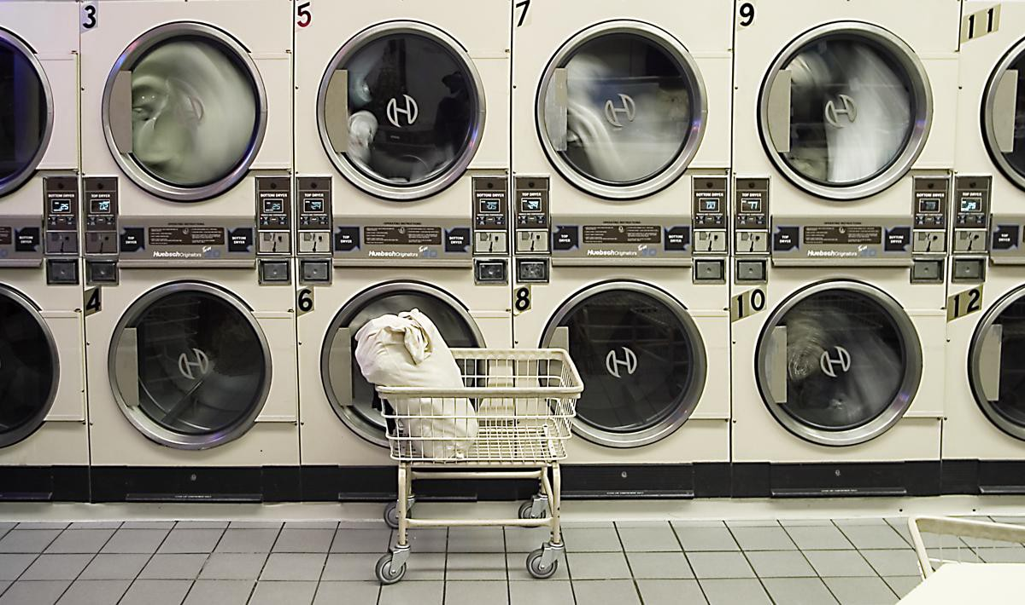
DE’Laundro Services
G4T4

